Slide 1

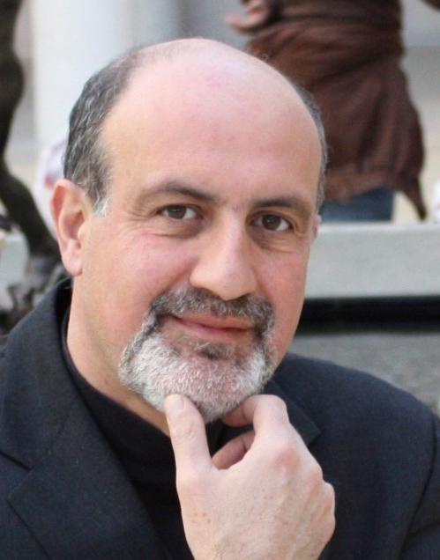

What are the Technical Errors on Covid?
A
Department of
Finance and Risk Engineering
In Person:
Event Makerspace – 6 Metrotech Center, 1st Floor
(Open to NYU Staff, Students and Faculty Only)
September 23rd at 6PM
Via Zoom (open to non-NYU members)
Meeting ID: 971 7885 1816
Passcode: BQENT923
Nassim Nicholas Taleb
Retired Distinguished Professor of Risk Engineering
Department of Finance and
Risk Engineering

